Slide 1
3G Admission Control simulator
Pasquale Marrancone
Michele Menarini
Gianluca Renzi

Slide 2
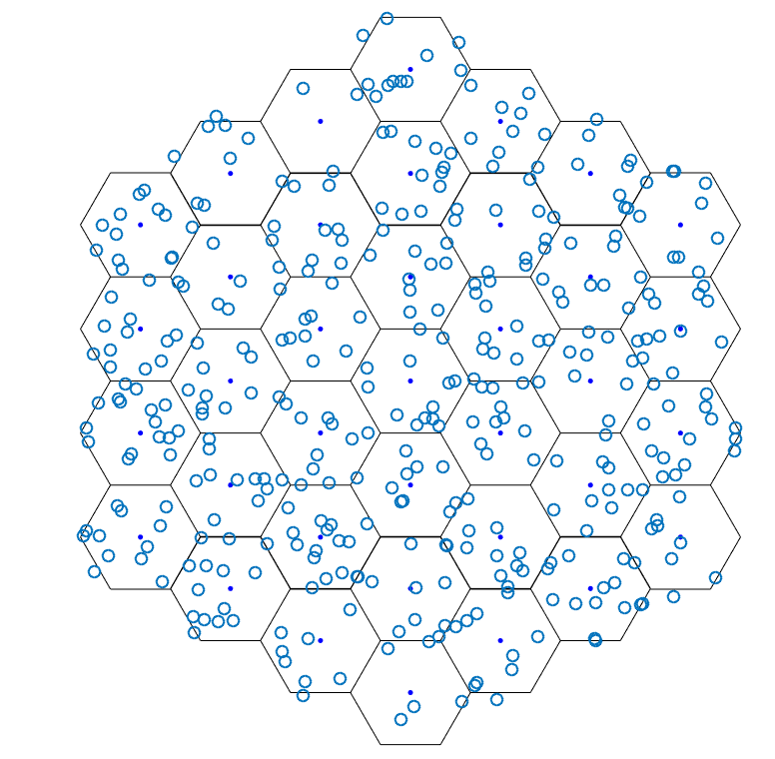
Scenario
Deterministic elements of infrastructure nodes
Number of Base Stations: 37
Reference BS for KPIs: 7
Radius: function of traffic density
Antenna diagram: omnidirectional
Required BLER: 10⁻²

Slide 3
Scenario (2)
Deterministic elements of infrastructure nodes
FEC: m=255, Rcod=0.5, t=18
Tsist : 1000° K
Receiver sensitivity: ????????? 10⁻¹⁵ W
Protection ratio: -12.71 dB
Ptmin = 4*10⁻⁸ W ????????????
Ptmax = 2 W

Slide 4
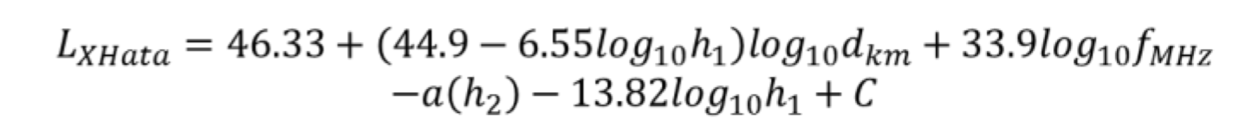
Scenario(3)
Deterministic elements of RRA
Bc = 5 MHz ; Rc=3.84 MChips/s
Simulated link: UL
Spreading Factor: 32 (i.e., video users Rb~100Kbit/s) ; NRU=32
Path loss model: extended Okumura Hata
h1 = 30 m; C = 0; fMHz = 2000
Standard deviation of Shadowing: 6 dB

Slide 5
Admission control algorithm
User k is admitted if Itot + ΔIk < Imax

Slide 6
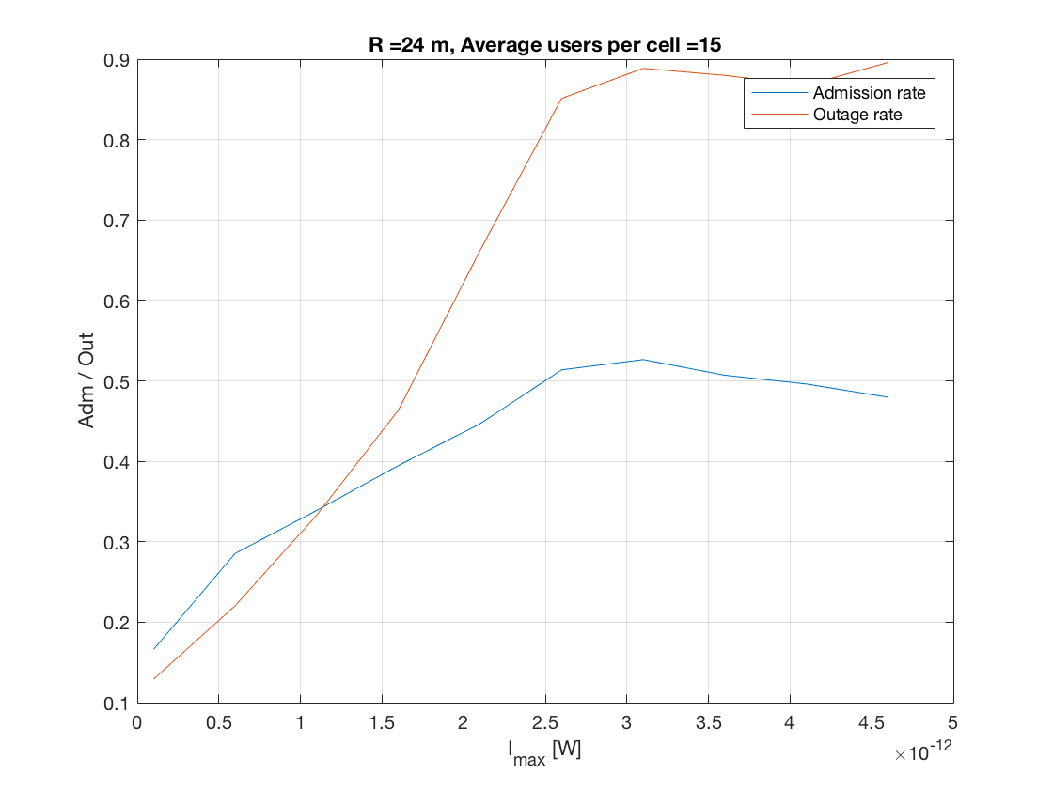
Traffic density: 1E in 100m²
Directed retry: best 3 servers

Slide 7
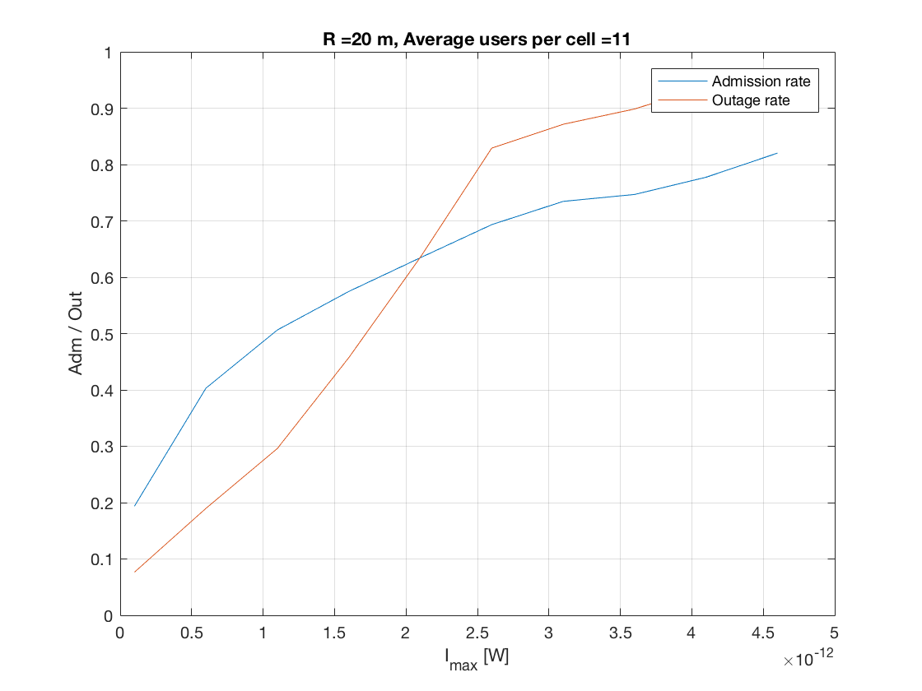

Slide 8
Altri grafici
Simulation with different PC
Change Pro (margin) and exponent

